Slide 1


ML Individual Assignment 2
Presented by Seo Shin Youn (S10205100K)
ML P04 Oct 2021 - Mr Zhou Weigui Jair
Notes:
[Speaker: Seo Shin Youn]
A very good morning, afternoon, or evening Mr Zhou and fellow classmates, my name is Shin Youn and I will be presenting my Machine Learning models that I have created for the hr analytics and Airbnb dataset respectively.
For this presentation, I will be providing a recap of the data transformation process I have done for assignment 1, share about the various classification models and regression models I have created, before ending off with a summary to evaluate which is the best model classification and regression model respectively.

Slide 2

TABLE OF CONTENTS
Recap from Assignment 1
HR Analytics (Classification)
01
Exploring hr_data_new.csv
Exploring listings_new.csv
02
Feature Selection
Splitting Training & Testing Data
Models: XGBoost, LightGBM, K-Nearest Neighbour, MLP Classifier
AirBnb (Regression)
Summary
03
Ordinal to One Hot Encoding
Splitting Training & Testing Data
Models: Linear Regression, XGBoost Regressor, Support Vector Regression
04
Best classification model (HR)
Best regression model (AirBnb)
Notes:
[Speaker: Seo Shin Youn]
For this presentation, I will be providing a recap of the data transformation process I have done for assignment 1, share about the various classification models and regression models I have created, before ending off with a summary to evaluate which is the best model classification and regression model respectively.

Slide 3
01
Recap from Assignment 1
Exploring hr_data_new.csv
Exploring listings_new.csv
Notes:
[Speaker: Seo Shin Youn]
Now I will be sharing more about the agenda for both the HR Analytics and AirBnB projects

Slide 4
HR Analytics Classification Problem
Key Data Transformation Processes
Step 1 - Deduplication of Data
Step 4 - Normalization/Feature Scaling
Log Transformation on ‘age’, ‘length_of_service’, ‘avg_training_score’
Step 2 - Missing value treatment
‘previous_year_rating’ → 0
‘education’ → Bachelor’s (mode)
Step 5 - Stratified Sampling
on Target Variable ‘is_promoted’
Step 3 - Ordinal encoding
‘department’, ‘education’, ‘gender’, ‘recruitment_channel’, ‘region’
Step 6 - Dropping features
‘employee_id’
Notes:
Moving to what has been demonstrated in Assignment 1, some of the data transformation process I had covered involved the deduplication of data (which there were no instances of), performing missing value treatment on previous_year_rating through the imputation of 0 given that they were only recently hired, as well as the imputation of Bachelor's given that it is the mode value of the education feature. Additionally, in order to use features such as the correlation matrix, I had also used ordinal encoding in order to transform object data types into a integer or float value and this columns included the department, education, gender, recruitment_channel, and region column. Additionally, as I had noticed that some of the features were large in scale, I had performed log transformation on age, length of service, and average training score, given that they were postively scaled. Last but not least, as the target variable was imbalanced I had performed stratified sampling to balance the target variable while also dropping the employee_id feature given that no meaningful value could be derived from it.

Slide 5
AirBnB Regression Problem
Key Data Transformation Processes
Step 4 - Focus on Subset of Price Range
Only Records with price range within IQR Range
Step 1 - Deduplication of Data
Step 5 - Ordinal Encoding
‘neighbourhood_group’, ‘neighbourhood’, ‘room_type’
Step 2 - Missing value treatment
‘name’ → column dropped
‘last_review’ → feature transformation with median number of days since last_review
‘Reviews_per_month’ → 0
Step 6 - Normalization/Feature Scaling
Log Transformation on ‘reviews_per_month’, ‘number_of_reviews’, ‘minimum_nights’, ‘calculated_host_listings_count’, ‘availability_365’
Step 3 - Focus on Subset of Region within E-W Line
Dropped records with ‘neighbourhood_group’
from ‘North Region’ and ‘North-East Region’
Notes:
Similarly for the AirBnB regression problem, I had also checked for any duplicated data which there were no instances of, performed missing value treatment on name by dropping it, imputing the median number of days since last review after performing feature transformation of the dates as well as imputing missing values in the review per month column given that the listings were mostly likely never reviewed at all. Additionally, as I would like to focus on a customized price prediction model, I had focused on the subset of region in the East-West line by dropping regions from the north and northeast as well as removing any price range that were beyond the interquartile range. Last but not least, I had performed ordinal encoding on the object datatypes involving neighbourh_group, neighobourhood, and room type before performing feature scaling on columns including ‘reviews_per_month’, ‘number_of_reviews’, ‘minimum_nights’, ‘calculated_host_listings_count’, ‘availability_365’, given that they were relatively larger in terms of value and were positively scaled by nature.

Slide 6
HR ANALYTICS
Classification problem
02
Feature Selection
Splitting Training & Testing Data
Models: XGBoost, LightGBM, K-Nearest Neighbour, MLP Classifier
Notes:
[Speaker: Seo Shin Youn]
Moving on, I will now be diving deeper into the HR Analytics classification problem and the related classification models I have created.

Slide 7
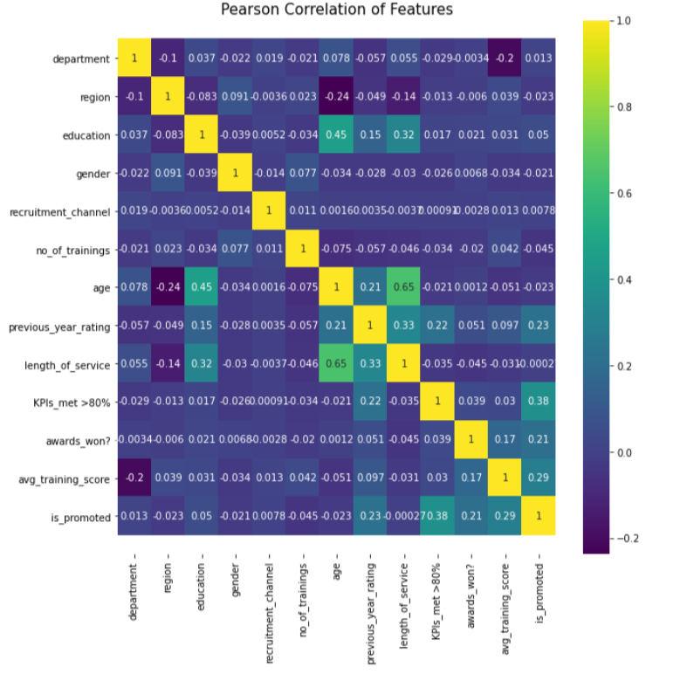
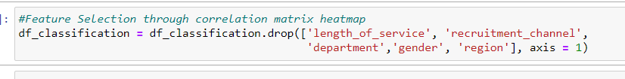
HR Analytics - Feature Selection
Feature Selection through dropping weak features:
‘length_of_service’ (0.0002)
‘recruitment_channel’ (0.0078)
‘department’ (0.013)
‘gender’ (-0.021)
‘region’ (-0.023)
Notes:
With the dataset that I had, one of the first processes that I had performed was to eliminate redundant and irrelevant data. Hence, by looking back at the correlation matrix I had previously created, I had removed 5 of the weakest features in terms of their correlation in determining promotion which includes length of service, recruitment channel, department, gender, and region. And this is because removing the irrelevant data improves learning accuracy, reduces the computation time, and facilitates an enhanced understanding for the learning model or data that we would be creating.

Slide 8
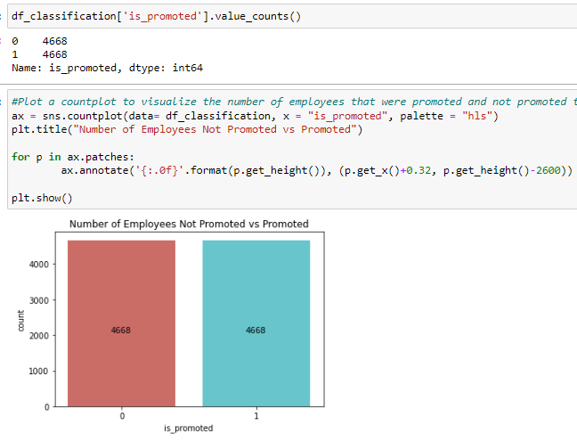
HR Analytics - Checking for imbalance dataset
Stratified sampling already performed in ASG1
4668 employees promoted vs 4668 not promoted
Notes:
Additionally, by checking for an imbalance data set, we could observe that we would not have to perform stratified sampling as the number of employees that were promoted and not promoted were already equal with a record count of 4668 each.

Slide 9
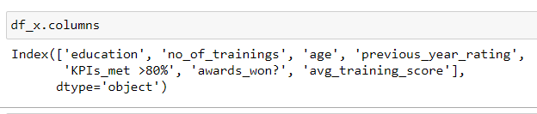
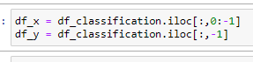
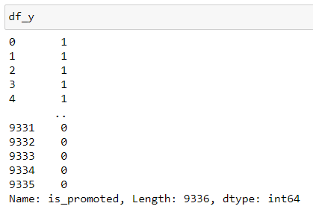
HR Analytics - Splitting Training & Testing Data
Splitting columns into input and output features
Splitting records into training and testing data:
80/20 split between training and testing data
Notes:
Furthermore, by selecting the output feature as price while the other columns act as the input features, I had split the records into training and testing data with 20% of data used for testing while the rest is used as training data.

Slide 10

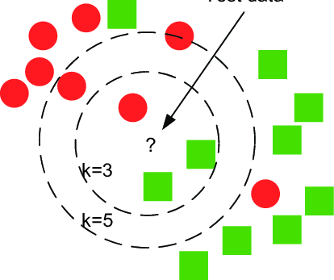
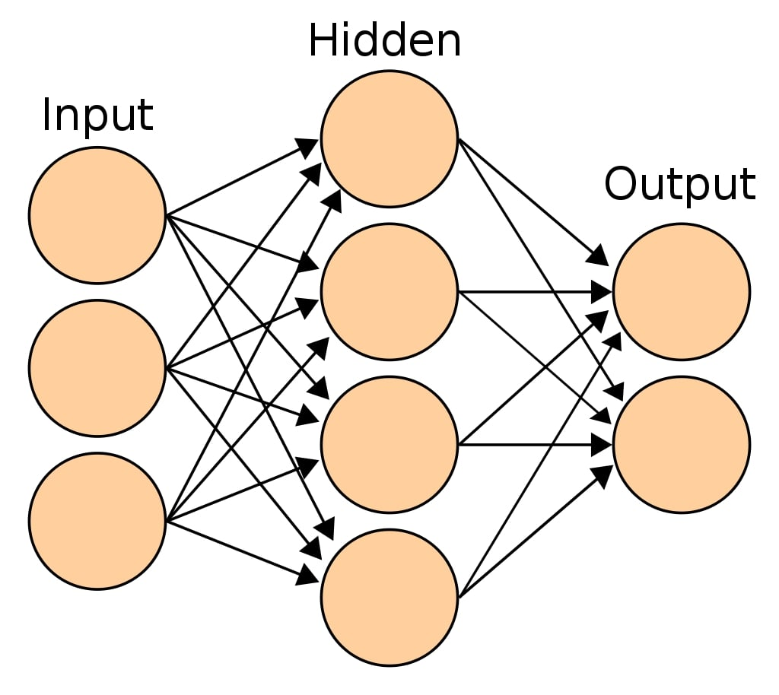

HR Analytics Overview
Classification models used in analyzing dataset
XGBClassifier
Decision-Tree based ensemble ML algorithm using gradient boosting framework
Why use XGBoost?
Performs well with numerical and categorical features as well as dataset with large number of training examples
LGBMClassifier
Decision-Tree based ensemble ML algorithm using gradient boosting framework
Why use LightGBM?
Faster training speed and higher efficiency due to its lower training speed. Often compared to XGBoost
KNeighborsClassifier
New data points are assigned a value based on how closely it matches the points (Euclidean distance)
Why use K-NN?
A popular algorithm in Machine Learning used for the purpose of binary classification. Suitable for our Dataset (promoted vs not promoted)
MLPClassifier
Feedforward artificial neural network that generates a set of output from a set of inputs
Why use MLP?
Performs well with numerical and categorical features as well as dataset with large number of training examples
Notes:
Hence, with that, the various models that I had considered as part of the HR analytics classification problem involves Extreme Gradient Boosting Classifier, Light Gradient Boosting Machine, K Neighbours classifier, and MultiLayer Perceptron model. To briefly introduce the model, XGBoost is a scalable, distributed gradient-boosted decision tree (GBDT) machine learning library which provides parallel tree boosting and is the leading machine learning classification problems. Hence, why I wanted to use XGBoost for the HR Analytics dataset was because it is a resilient and robust method that prevents and cubs overfitting quite easily. Likewise, as the LightGradientBoostingMachine is often compared against the XGBoost model due its ability to process much faster while also providing a better approach to dealing with large datasets, I wanted to see how it would compare against the XGBoost model. Futhermore, as both LightGBM and XGBoost are ensemble techniques I wanted to explore how other classifiers such as K-Nearest neighbour and MLP Classifier would perform given that they are popular models for binary classification which suits our classification problem.

Slide 11
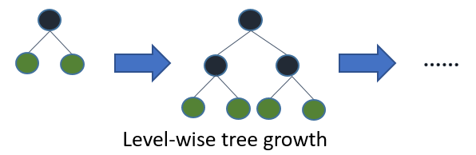
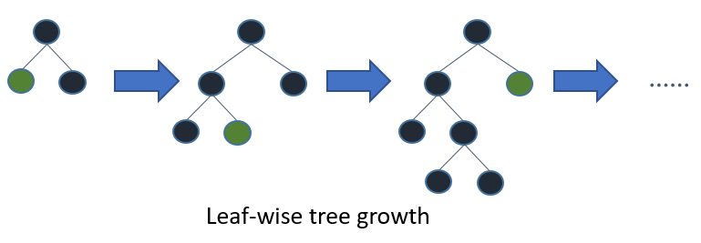
HR Analytics - Ensemble Techniques
Extreme Gradient Boosting vs Light Gradient Boosting Machine
XGBoost
Level-wise tree growth
Benefit - Capability of building robust models
compared to LightGBM (Better scalability)
Disadvantage - Training time increases
linearly with sample size
LightGBM
Leaf-wise tree growth (more loss reduction → Higher accuracy)
Benefit - Faster training speed and accuracy
Disadvantage - May result in overfitting
Notes:
So what exactly are the differences between the XGBoost and LightGBM ensemble techniques? Well firstly, the main difference is that XGBoost is a level-wise tree growth technique similiar to other decision tree models as seen from the diagrams on the right, while LightGBM on the other hand grows trees leaf-wise such that the algorithm would tend to achieve lower loss than level-wise algorithms. How, although LightGBM probides faster training speed and accuracy, leaf-wise methods tend to cause overfitting when the number of data is small.

Slide 12
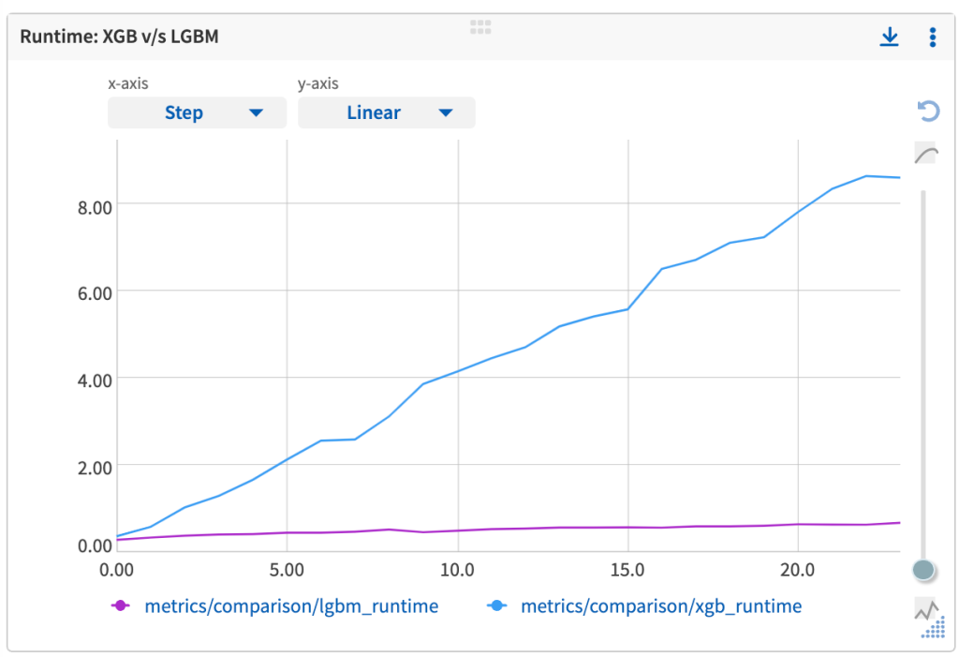
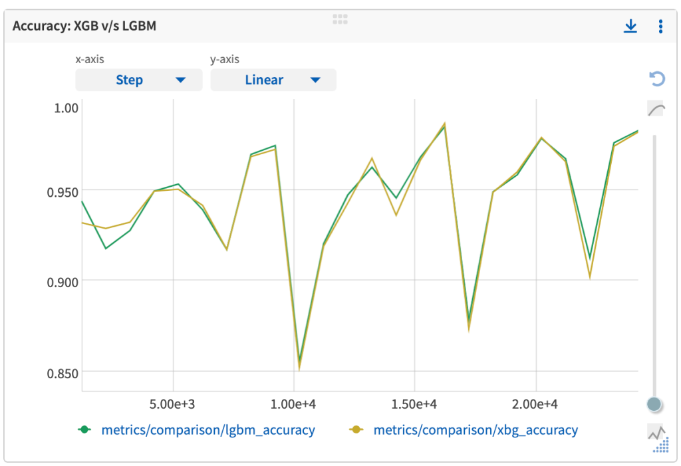
HR Analytics - Ensemble Techniques
Extreme Gradient Boosting vs Light Gradient Boosting Machine
Runtime performance comparison
LightGBM has a fraction of the training
time required by XGB
Accuracy performance comparison
Accuracy for both models are similar
Notes:
Additionally, from the figure above, we can see that the training time for XGBoost kept on increasing with an increase in sample size almost linearly. while on the other hand, the training time required by LightGBM has been a very small fraction of its contender. Furthermore, from the figure on the right, we could observe that the accuracy scores for both models go hand-in-hand. Hence, it would interesting to compare the two models as the results indicate that not only is LightGBM faster, but there is not much compromise in model performances.

Slide 13
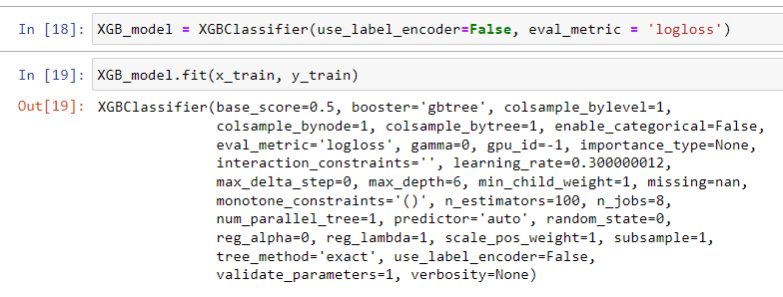
HR Analytics - XGBoost Classifier
Step 1: Building XGBClassifier model and adjust weights using .fit function
Why ‘Eval_metric’ = ‘logloss’?:
Log loss takes into account the uncertainty of the prediction based on how much it varies from the actual label. Good evaluation metric for binary classification
Notes:
Thus, to build the Extreme Gradient Boosting Classifier, I had firstly created an XGBClassifier model and had used fit function to adjust the weights of the parameters accordingly. Hence, the reason I had used logloss as part of the evaluation metric was because it would penalize false classifications by taking into account the probability of classification. Hence, the more the predicted probability diverges from the actual value, the higher is the log-loss value.

Slide 14
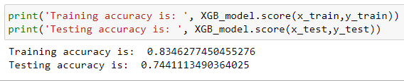
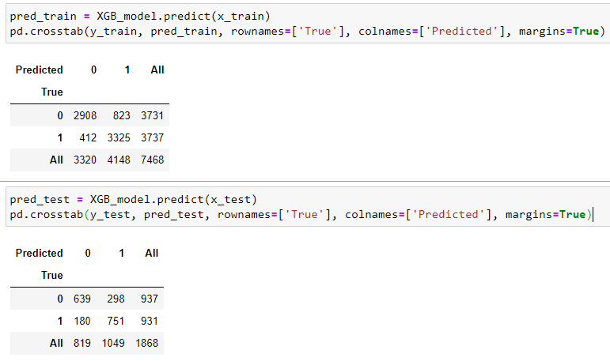
HR Analytics - XGBoost Classifier
Step 2: Evaluating XGBoost model before hyperparameter tuning
Slightly overfitting:
Presence of high variance and little bias
Cross-validation and hyperparameter tuning can be used to prevent overfitting

Slide 15
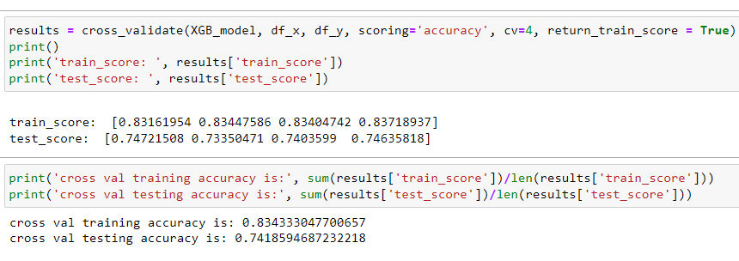
HR Analytics - XGBoost Classifier
Step 3: Testing predictive performance of XGBoost on new data
7468 Training Sample
With 1868 testing sample: Cross-validation of 4 is used to evenly split the data sample
As expected, a slight decrease in testing accuracy could be observed when assessing the predictive performance on new data

Slide 16
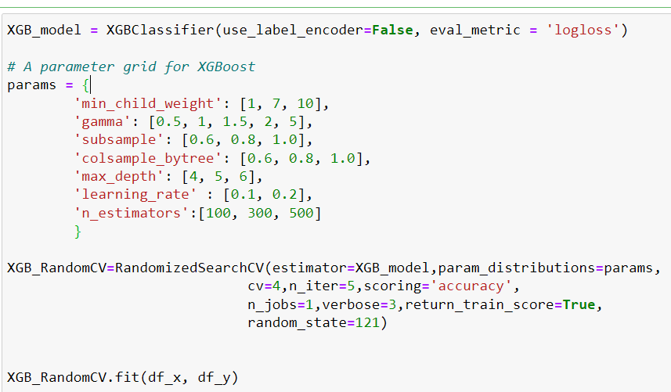
HR Analytics - XGBoost Classifier
Step 4.1: Selecting hyperparameters to compare to prevent overfitting
Key selections considered:
Higher min_child_weight (default = 1) selected to control overfitting by preventing the model from learning relations which might be highly specific to the particular sample selected.
Lower subsample (default = 1) selected to prevent overfitting as lower values make the algorithm more conservative
Lower max_depth (default = 6) selected to control over-fitting as higher depth will allow model to learn relations very specific to a particular sample.

Slide 17
HR Analytics - XGBoost Classifier
Step 4.2: Why RandomizedSearchCV for Hyperparameter tuning?
Why RandomizedSearchCV over GridSearchCV:
Random Search is a technique where random combinations of the hyperparameters are used to find the best solution with high efficiency compared to GridSearchCV.
The chances of finding the optimal parameter is comparatively higher in random search because of the random search pattern where the model might end up being trained on the optimised parameters without any aliasing.
GridSearchCV looks only at fixed points where the optimal points may not be in the set of fixed points.

Slide 18
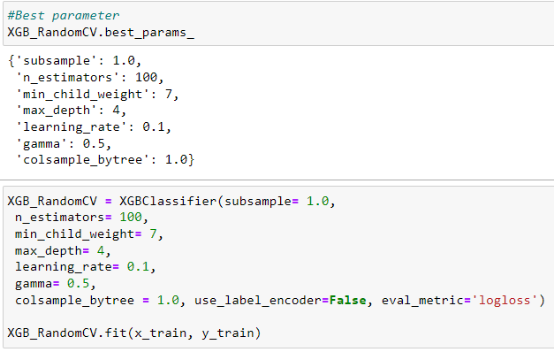
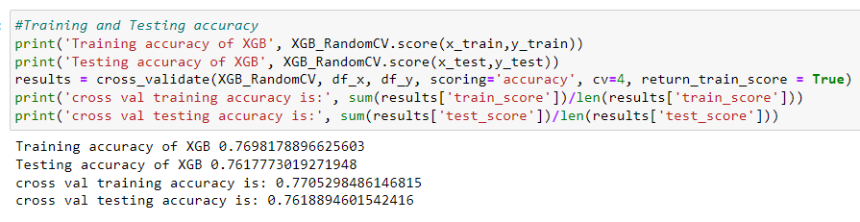
HR Analytics - XGBoost Classifier
Step 4.3: Building based on .best_params_ from RandomizedSearchCV
Training, Testing, & Cross-Validation accuracy:
Based on K-fold cross-validation, training accuracy has decreased from 83.43% to 77.05% while testing accuracy has improved from 74.19% to 76.19% + Prevented overfitting

Slide 19
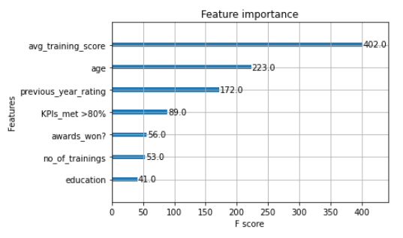
HR Analytics - XGBoost Classifier
Step 5: Feature Importance using F-score metric
avg_training_score is the most useful feature in predicting promotion
(i.e. F Score of 402, the feature was split 402 times on)
education is among the least useful feature in predicting promotion
(i.e. F Score of 41, the feature was split 41 times on)

Slide 20
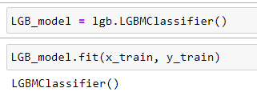
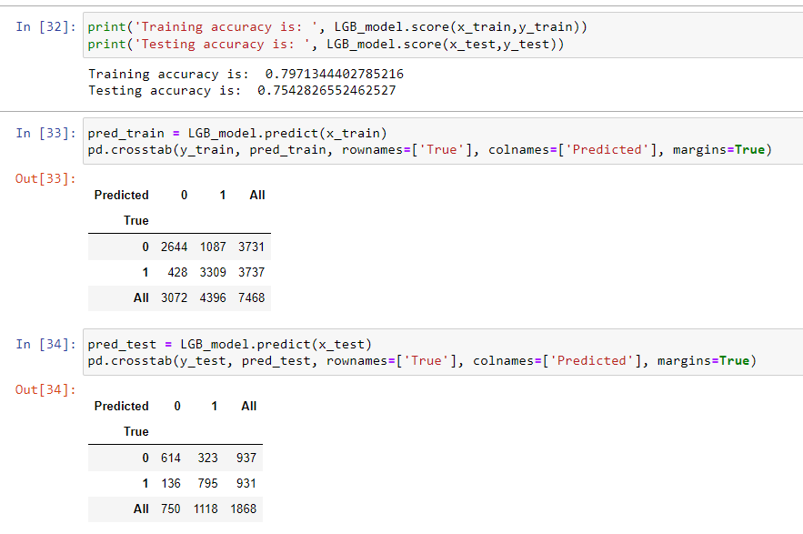
HR Analytics - LightGBM Classifier
Step 1: Building LightGBM Classifier model and adjust weights using .fit function
Step 2: Evaluating LightGBM model before hyperparameter tuning
Slightly overfitting:
Presence of slightly high variance and small bias
Cross-validation and hyperparameter tuning can be used to prevent overfitting

Slide 21
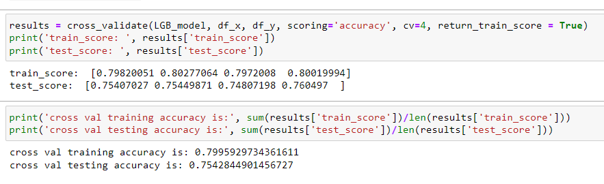
HR Analytics - LightGBM Classifier
Step 3: Testing predictive performance of LightGBM on new data
7468 Training Sample
With 1868 testing sample: Cross-validation of 4 is used to evenly split the data sample
An insignificant increase in both training accuracy and testing accuracy had been observed

Slide 22
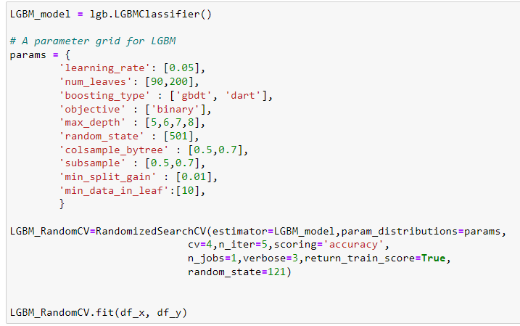
HR Analytics - LightGBM Classifier
Step 4.1: Selecting hyperparameters for better accuracy and dealing with over-fitting
Key selections considered:
Learning rate, which represents the shrinkage rate is lowered (default = 0.1) for better accuracy
Num_leaves, which represents the max number of leaves in one tree is increased for better accuracy (default = 31)
Max_depth set to avoid growing deep trees and prevent overfitting
Colsample_bytree and subsample set lower to deal with overfitting

Slide 23
HR Analytics - LightGBM Classifier
Step 4.2: Why RandomizedSearchCV for Hyperparameter tuning?
Key selections considered:
Random Search is a technique where random combinations of the hyperparameters are used to find the best solution with high efficiency compared to GridSearchCV.
The chances of finding the optimal parameter is comparatively higher in random search because of the random search pattern where the model might end up being trained on the optimised parameters without any aliasing.
GridSearchCV looks only at fixed points where the optimal points may not be in the set of fixed points.

Slide 24
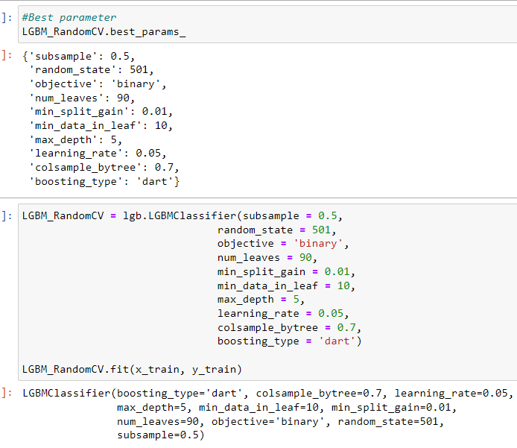
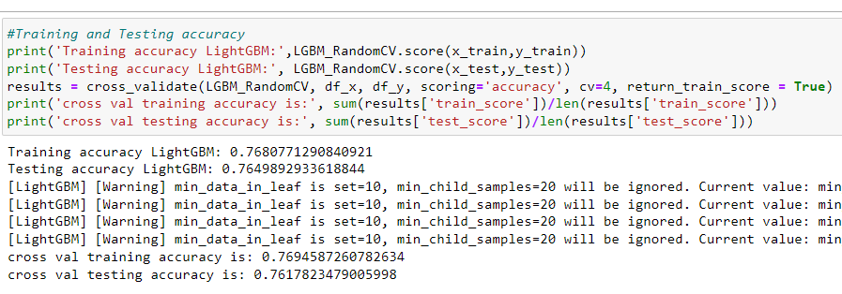
HR Analytics - LightGBM Classifier
Step 4.3: Building based on .best_params_ from RandomizedSearchCV
Training, Testing, & Cross-Validation accuracy:
Based on K-fold cross-validation, training accuracy has decreased from 79.96% to 76.95% while testing accuracy has improved from 75.43% to 76.18% + Prevented overfitting

Slide 25
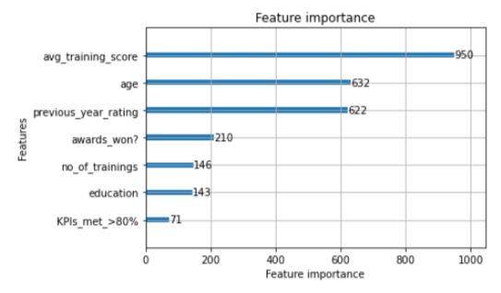
HR Analytics - LightGBM Classifier
Step 5: Feature Importance using F-score metric
avg_training_score is the most useful feature in predicting promotion
(i.e. F Score of 950, the feature was split 950 times on)
KPIs_met_>80% is among the least useful feature in predicting promotion
(i.e. F Score of 71, the feature was split 71 times on)

Slide 26
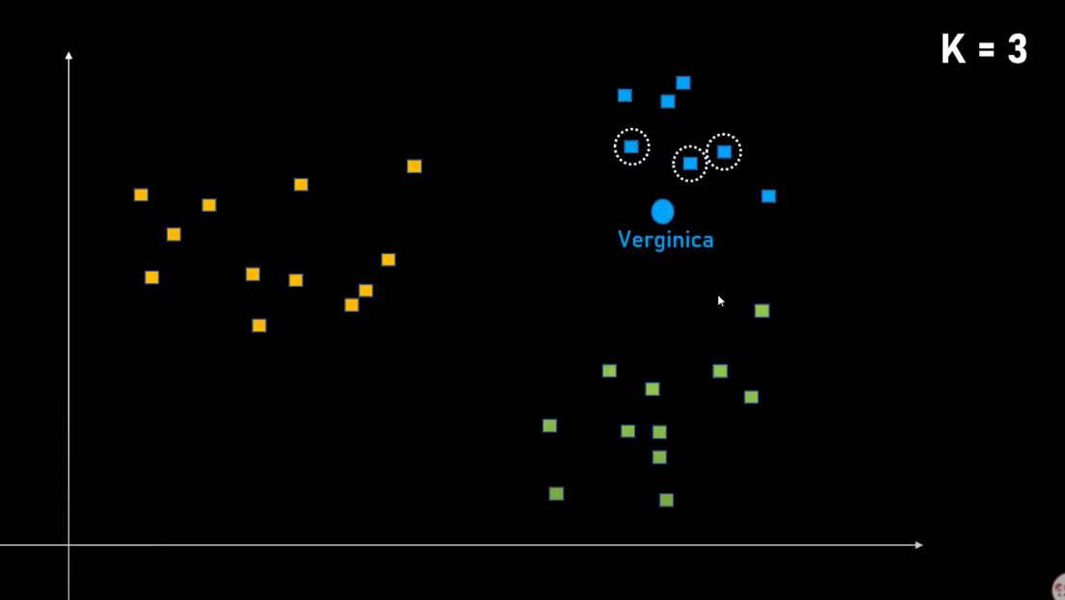
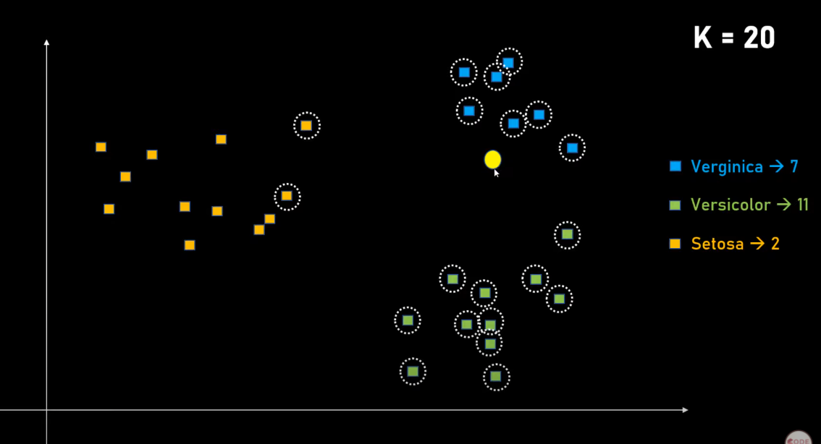
HR Analytics - K-Nearest Neighbour
What is K-Nearest Neighbour?
How do we determine which is the best K-Value?
When K = 3, the classifier finds the 3 nearest point
When K = 20, the classifier finds the 20 nearest point

Slide 27
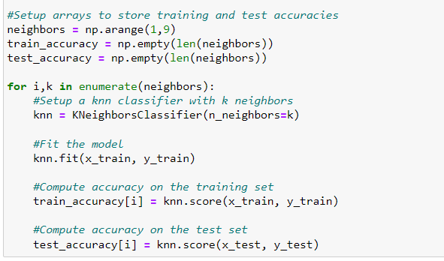
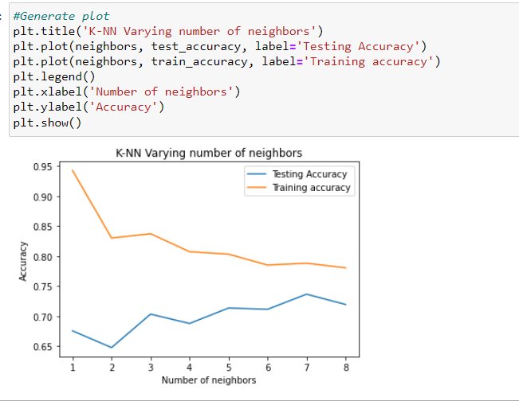
HR Analytics - K-Nearest Neighbour
Step 1: Determining the best K Value through modelling and Plotting
Store training and testing accuracy regarding different value of n_neighbours (K) for analysis
We can observe that KNN has the highest testing accuracy when n_neighbours value = 7

Slide 28
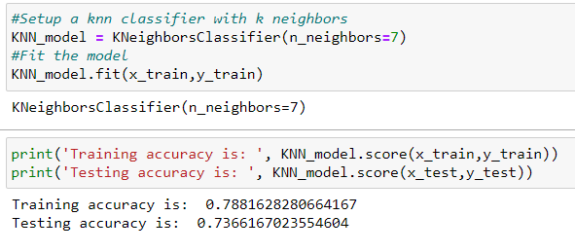
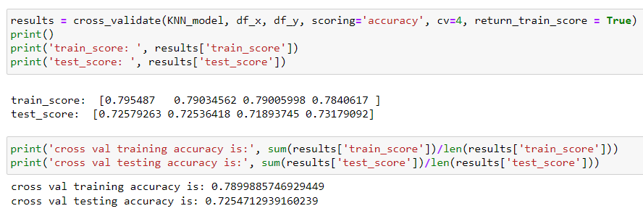
HR Analytics - K-Nearest Neighbour
Step 2: Building and evaluating KNN model with K = 7
Before performing K-fold cross validation:
After performing K-fold cross validation:
Slight Overfitting present → Use Gridsearch to test a larger range of n_neighbours (K) values alongside testing other parameters

Slide 29
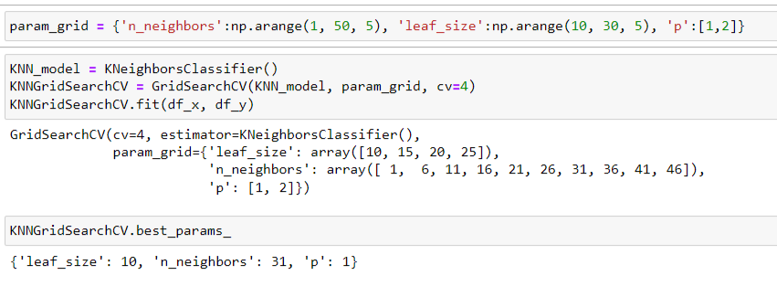
HR Analytics - K-Nearest Neighbour
Step 3: Hyperparameter tuning with GridsearchCV
Key selections considered:
Larger range of n_neighbors used to increase search parameter to find higher testing accuracy
Lower range of leaf_size (default = 30) used → Further the neighbours the algorithm picks
P value test between 1 and 2 used to determine whether manhattan distance (1) or euclidean distance (2) would be more optimal
Smaller leaf size, larger n_neighbors, and use of manhattan distance compared to default model

Slide 30
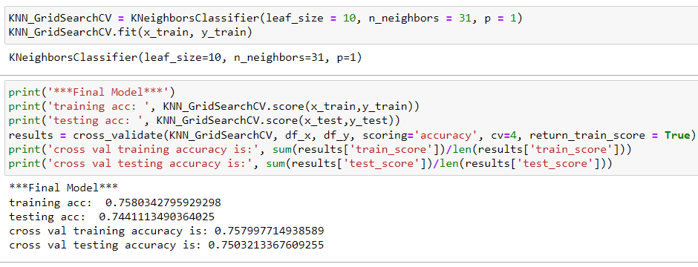
HR Analytics - K-Nearest Neighbour
Step 4: KNN GridsearchCV Model evaluation
Based on K-fold cross-validation, training accuracy has decreased from 79.00% to 75.80% while testing accuracy has significantly improved from 72.54% to 75.03% + Prevented overfitting

Slide 31
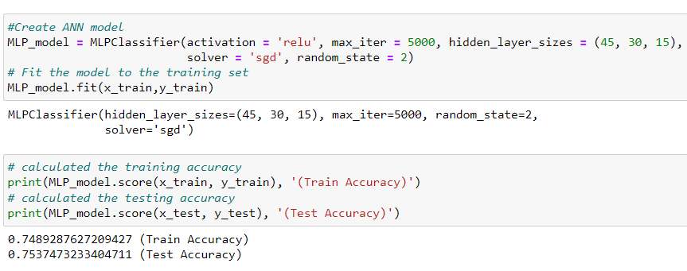
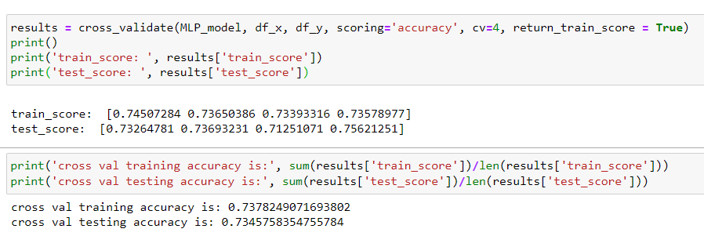
HR Analytics - Multilayer Perceptron Classifier
Step 1: Building and evaluate MLP CLassifier
Before performing K-fold cross validation:
After performing K-fold cross validation:
Testing accuracy is marginally higher than training accuracy → Underfitting

Slide 32
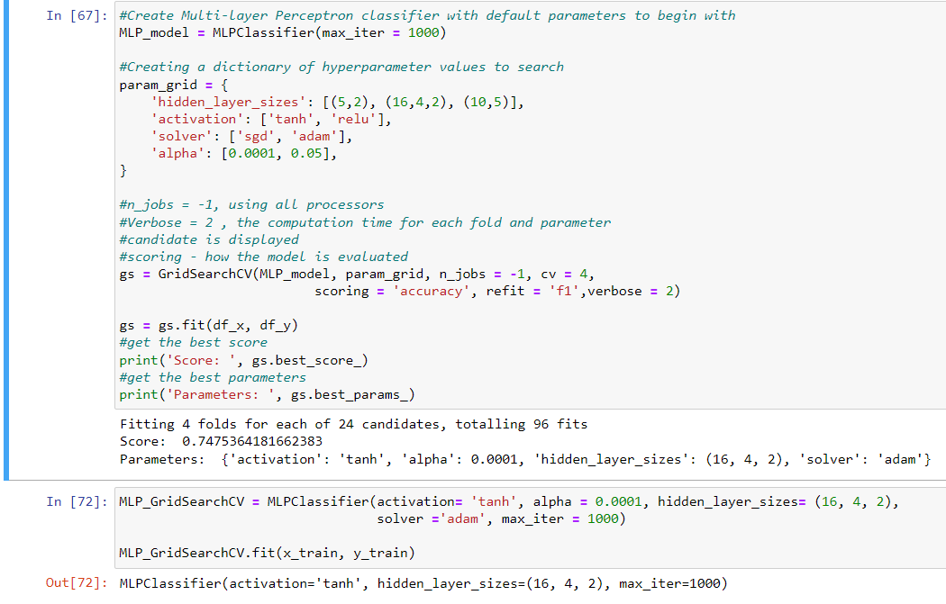
HR Analytics - Multilayer Perceptron Classifier
Step 2: Hyperparameter tuning with GridsearchCV
GridsearchCV → Build model → Fit model
Key selections considered:
Testing 2 or more hidden layer sizes (default = (100, )) → more accurate approximation with fewer weights
Activation_function to be tested: tanh, relu
(more computationally efficient)
Solver to be tested: stochastic gradient descent, adam (computes faster)
Alpha → reduces overfitting through regularization
Notes:
Each unit in the second hidden layer enables the ANN to fit a separate hill or valley. So an MLP with two hidden layers can often yield a more accurate approximation with fewer weights than an MLP with one hidden layer

Slide 33
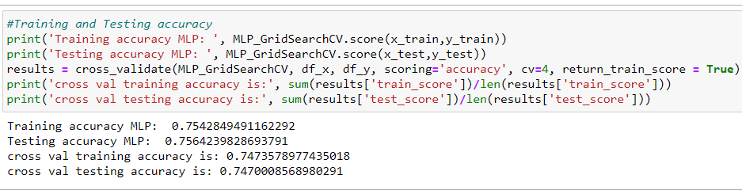
HR Analytics - Multilayer Perceptron Classifier
Step 3: MLP GridsearchCV Model evaluation
Based on K-fold cross-validation, training accuracy has increase from 73.78% to 74.74% while testing accuracy has improved from 73.46% to 74.70% + Reduce underfitting

Slide 34
AIRBNB
Regression problem
03
Exploratory Data Analysis
Data Cleansing and Transformation
Correlation Analysis
Notes:
[Speaker: Seo Shin Youn]
Now I will be diving deeper into my analysis of the AIRBNB Regression problem, in the order of exploratory data analysis in unit 3.1, data cleansing and transformation in unit 3.2, and the analysis of correlation in unit 3.3.

Slide 35
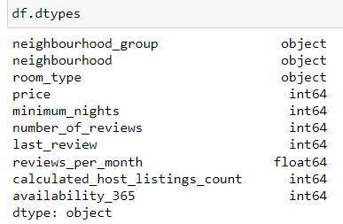
Airbnb - Ordinal Encoding to One Hot Encoding
Previously in Assignment 1:
Ordinal encoding had been used to convert object data types into integer values
Inappropriate for categorical values with unknown relationship (e.g. neighbourhood)
In Assignment 2:
One Hot Encoding to be implemented
Appropriate for categories with unknown relationship
Features to perform One Hot Encoding on:
Notes:
[Speaker: Seo Shin Youn]
For both HR Analytics and AirBNB dataset, the data cleansing and transformation approach I had utilized is based on a Neural Network ML model instead of a Decision Tree that we are all familiar with.
Additionally, as of current Assignment, as we have only been taught how to utilize ordinal encoding, we would be using it in encoding the features with object data type. However, on thing to note would be that Ordinal Encoding is not a suitable approach for categorical variable object data type with no relationship to one another. This is because one value of a feature may not necessarily be bigger than the other value in the same feature. Hence, if we were to build the Neural Network model in assignment 2, a better suited approach would be to utilize One Hot Encoding instead which I would be implementing in the following assignment.
With One Hot Encoding, this is where the integer encoded variable is removed and a new binary variable is added for each unique integer value whereby there is no effect on the order. Furthermore, as we are using a Neural Network model, feature scaling would be necessary as if it is not being performed, a model with large weight values is often unstable, meaning that it may suffer from poor performance during learning and sensitivity to input values resulting in higher generalization error. Hence, with that being said the most commonly used normalization approach that I would be using would involve Log Transformation as we would later in see in further parts of the slides that many relevant numerical features in both dataset are positively skewed.
Hence, Log Transformation would be best equipped to handle positively skewed data. Last but not least, for the HR analytics classification problem exclusively, we would need to perform stratified sampling to ensure that the target variable has equal number of data on both side of the spectrum, making sure that each subgroup of interest is represented while our price prediction model of the AirBnB dataset would focus on listings along the East West Line.

Slide 36
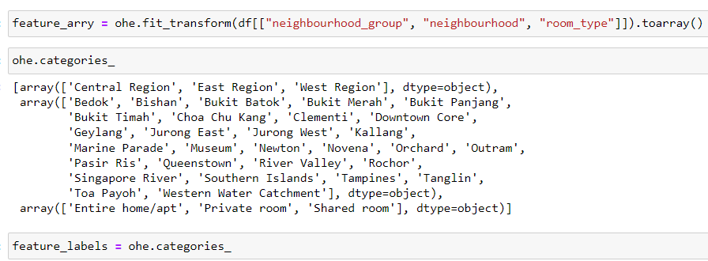
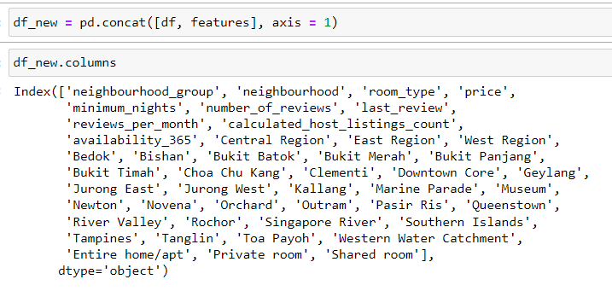
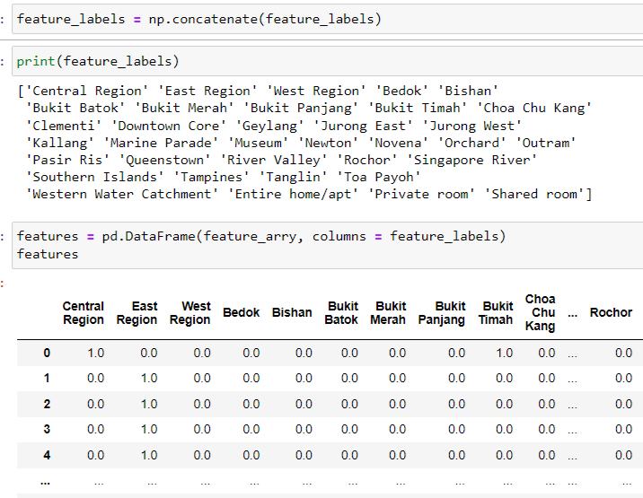
Airbnb - Performing One Hot Encoding
Step 1 - One Hot Encode categorical values +store labels into variable
Step 3 - Concatenate original and one hot encoded dataframe
Step 2 - Concatenate list of arrays into a single list + Create dataframe of One Hot Encoded features
Notes:
[Speaker: Seo Shin Youn]
For both HR Analytics and AirBNB dataset, the data cleansing and transformation approach I had utilized is based on a Neural Network ML model instead of a Decision Tree that we are all familiar with.
Additionally, as of current Assignment, as we have only been taught how to utilize ordinal encoding, we would be using it in encoding the features with object data type. However, on thing to note would be that Ordinal Encoding is not a suitable approach for categorical variable object data type with no relationship to one another. This is because one value of a feature may not necessarily be bigger than the other value in the same feature. Hence, if we were to build the Neural Network model in assignment 2, a better suited approach would be to utilize One Hot Encoding instead which I would be implementing in the following assignment.
With One Hot Encoding, this is where the integer encoded variable is removed and a new binary variable is added for each unique integer value whereby there is no effect on the order. Furthermore, as we are using a Neural Network model, feature scaling would be necessary as if it is not being performed, a model with large weight values is often unstable, meaning that it may suffer from poor performance during learning and sensitivity to input values resulting in higher generalization error. Hence, with that being said the most commonly used normalization approach that I would be using would involve Log Transformation as we would later in see in further parts of the slides that many relevant numerical features in both dataset are positively skewed.
Hence, Log Transformation would be best equipped to handle positively skewed data. Last but not least, for the HR analytics classification problem exclusively, we would need to perform stratified sampling to ensure that the target variable has equal number of data on both side of the spectrum, making sure that each subgroup of interest is represented while our price prediction model of the AirBnB dataset would focus on listings along the East West Line.

Slide 37
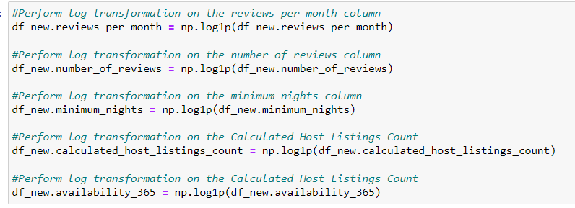
Airbnb - Perform Feature Scaling as per ASG1
Perform log transformation once again as feature transformation processes from Ordinal Encoding onwards had been removed from dataset:
Notes:
[Speaker: Seo Shin Youn]
For both HR Analytics and AirBNB dataset, the data cleansing and transformation approach I had utilized is based on a Neural Network ML model instead of a Decision Tree that we are all familiar with.
Additionally, as of current Assignment, as we have only been taught how to utilize ordinal encoding, we would be using it in encoding the features with object data type. However, on thing to note would be that Ordinal Encoding is not a suitable approach for categorical variable object data type with no relationship to one another. This is because one value of a feature may not necessarily be bigger than the other value in the same feature. Hence, if we were to build the Neural Network model in assignment 2, a better suited approach would be to utilize One Hot Encoding instead which I would be implementing in the following assignment.
With One Hot Encoding, this is where the integer encoded variable is removed and a new binary variable is added for each unique integer value whereby there is no effect on the order. Furthermore, as we are using a Neural Network model, feature scaling would be necessary as if it is not being performed, a model with large weight values is often unstable, meaning that it may suffer from poor performance during learning and sensitivity to input values resulting in higher generalization error. Hence, with that being said the most commonly used normalization approach that I would be using would involve Log Transformation as we would later in see in further parts of the slides that many relevant numerical features in both dataset are positively skewed.
Hence, Log Transformation would be best equipped to handle positively skewed data. Last but not least, for the HR analytics classification problem exclusively, we would need to perform stratified sampling to ensure that the target variable has equal number of data on both side of the spectrum, making sure that each subgroup of interest is represented while our price prediction model of the AirBnB dataset would focus on listings along the East West Line.

Slide 38
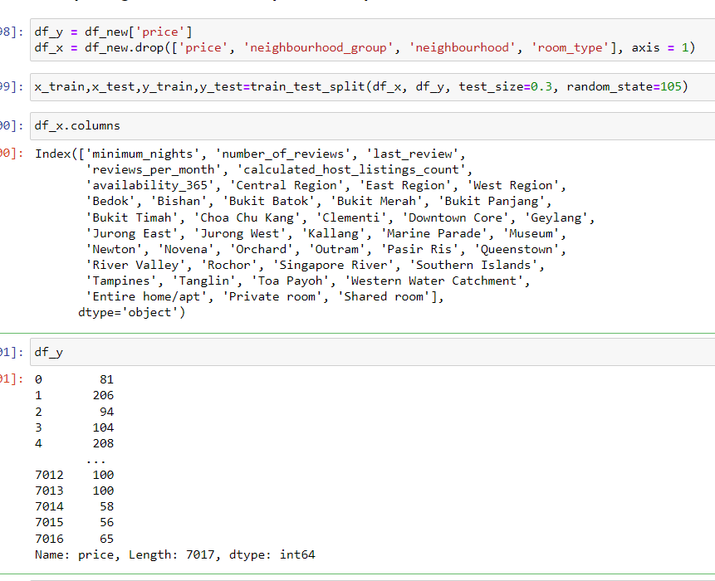
Airbnb - Split Training & Testing Data
Splitting columns into output feature (i.e price) and
Input features (i.e. other columns except features that have already been One Hot Encoded)
Splitting records into training and testing data: 70/30 split

Slide 39
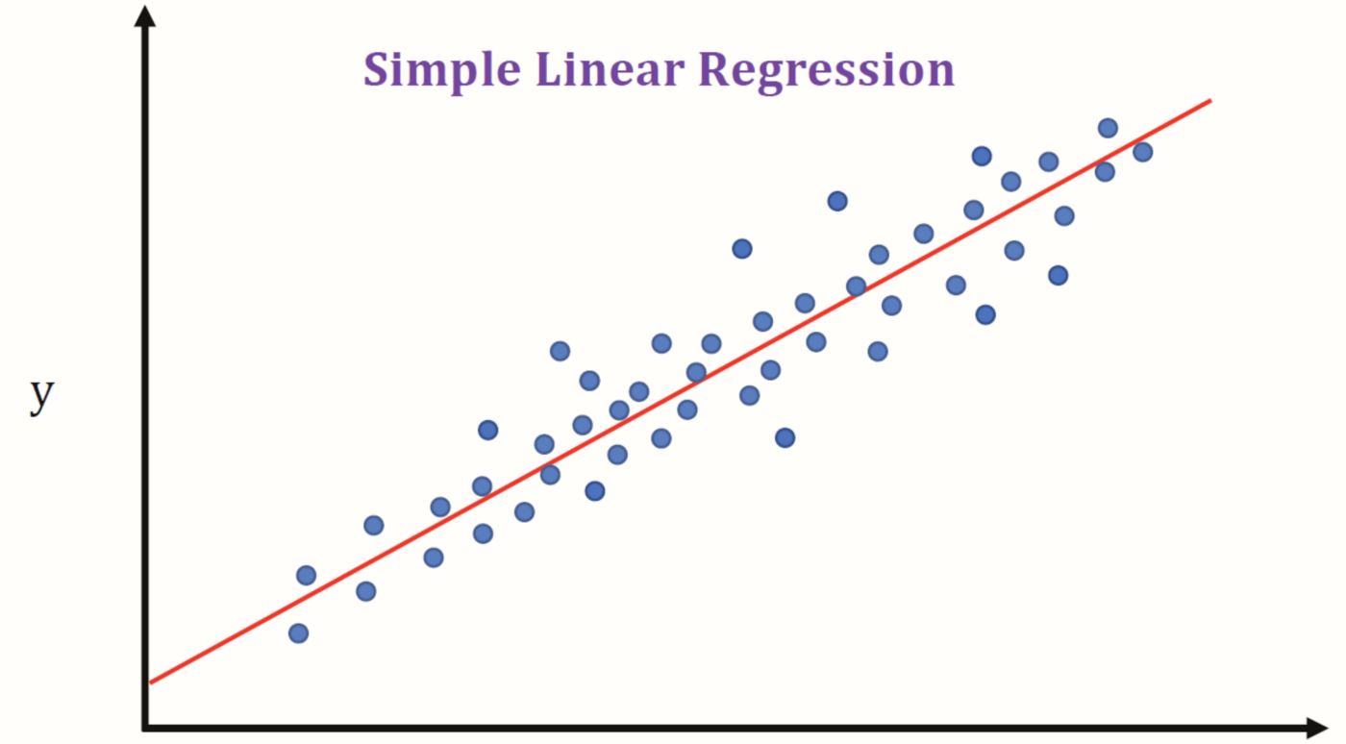
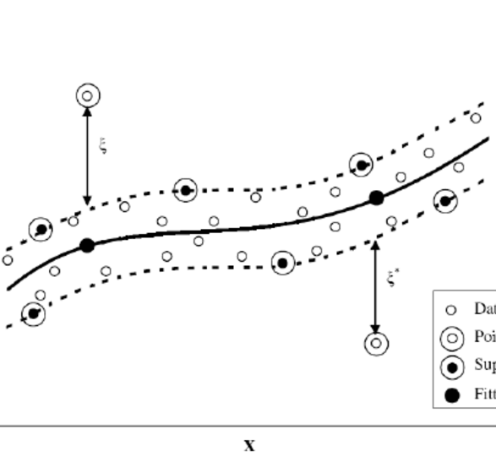
AirBnb Overview
Regression models used in analyzing dataset
Linear Regression
Ordinary Least Squares procedure seeks to minimize the sum of the squared residuals. Allows user to vie
Why use Linear Regression?
The Ordinary Least Squares procedure would be suitable given that we have more than one input
XGBoost Regressor
XGBoost is a powerful approach for building supervised regression models
Why use XGBoost Regressor?
It is faster than Gradient Boosting
Support regularization to overcome overfitting
Uses the power of parallel processing
Support Vector Regression
SVR allows us to choose how tolerant we are of errors
Why use SVR?
Robust to outliers
Excellent generalization capability, with high prediction accuracy
Notes:
[Speaker: Seo Shin Youn]

Slide 40
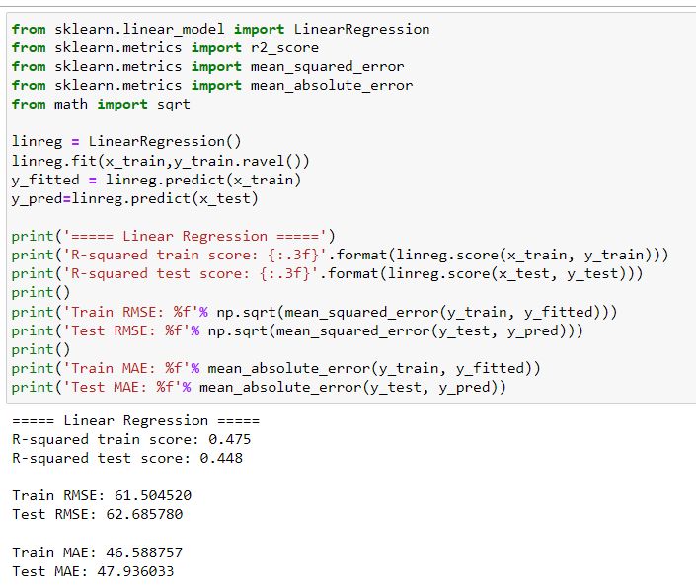
AirBnb - Linear Regression Model
Step 1: Building and evaluating Linear Regression model
Regression model metrics may seem to perform poorly as price output remains unscaled:
Model only explains 44.8% of variation on testing data
Test RMSE and MAE are marginally higher than their the Train RMSE and MAE
→ No obvious overfitting

Slide 41
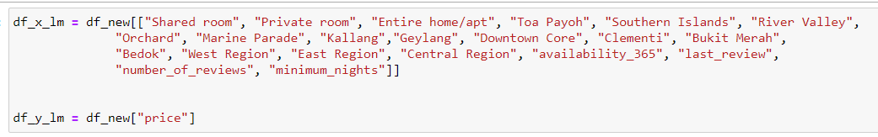
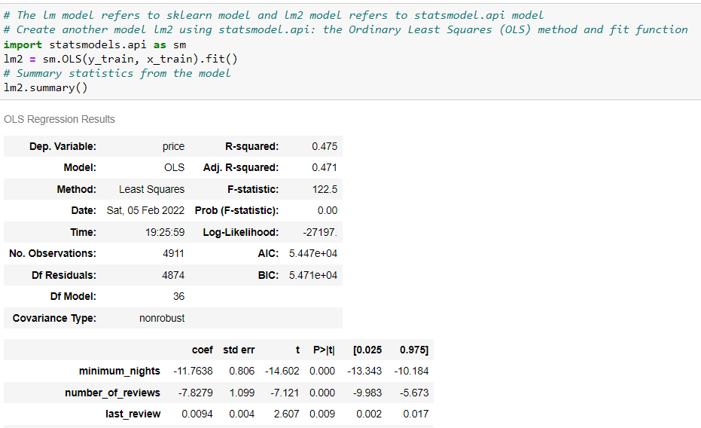
AirBnb - Linear Regression Model
Step 2: Ordinary Least Square Method and fit function
Based on the OLS model summary, only columns with close to ZERO p-value (i.ethe column P>|t| ) are selected.
Close to zero P value → high confidence & strong indicators
High P-value → low confidence & weak indicators

Slide 42

AirBnb - Linear Regression Model
Step 3: Ordinary Least Square Model Evaluation
Create Linear Regression model based on subset of input
data frame selected:
R-Squared Test Score: 0.448 → 0.453 (Model is able to better explain variation)
RMSE Test Score: 62.69 → 62.79 (Model has slightly worse fit)
MAE Test Score: 47.94 → 47.58 (Slightly smaller absolute error)

Slide 43


AirBnb - XGBoost Regressor
Step 1: Building & evaluating XGBRegressor model
Regression model comparison metric - RMSE & R-Squared:
Create XGBoost Regressor Model using default parameters:
Much Higher R-Squared Train Score compared to Test Score
→ Slightly overfitting

Slide 44


AirBnb - XGBoost Regressor
Step 2: Find best max_depth value to determine model complexity
Without Cross-Validation measures:
Store train_mse and test_mse values based on range of max_depth value from 2 to 9:
With Cross-Validation measures
Testing MSE increases after max_depth = 6
Use max_depth = 6

Slide 45

AirBnb - XGBoost Regressor
Step 3: Improved XGBoost Model evaluation based on best max_depth found
Before and After comparison:
Testing RMSE
53.806 → 52.133
(Model has a slightly better fit)
Cross-Validated RMSE
59.219 → 56.493
(Model has a better fit)
Testing R-Squared Value
0.593 → 0.618
(Model is able to explain 61.8% of variation + reduced overfitting)

Slide 46

AirBnb - Support Vector Regression model
Step 1: Building & evaluating SVR model
Building SVR Model:
‘Linear’ → Assumes data is linearly separable
‘Gamma’ → Kernel coefficient
C = 0.1 → Default value
(Small margin of regularization)
R-Squared score are very low
Model Only able to explain 31.5% of variation

Slide 47

AirBnb - Support Vector Regression model
Step 2: Using RandomizedSearchCV to improve model performance
Parameters used in RandomizedSearchCV
Testing between linear and polynomial kernel
Testing higher C Value (default = 1) for larger
margin of regularization
Degree of the polynomial kernel function
Coef0 - control how the model is influenced by high degree polynomial
Best parameters to build model

Slide 48


AirBnb - Support Vector Regression model
Step 3: Evaluating SVR model based on best parameters found
Before and After RandomizedSearchCV:
Testing RMSE
69.848 → 64.793
(Model has a much better fit)
Cross-Validated RMSE
69.994 → 65.261
(Model has a much better fit)
Testing R-Squared Value
0.315 → 0.410
(Model is able to explain 41.0% of variation + slightly reduced overfitting)

Slide 49
Summary of Findings
04
Findings of the two datasets
Possible further improvements
Notes:
[Speaker: Seo Shin Youn]
Thus, based on the challenges I have identified from the perspective of businesses worldwide...

Slide 50




HR Analytics - Ranking from Best to Worst Model
Extreme Gradient Boosting Classifier
Cross-validated Training Accuracy (77.053%)
Cross-validated Testing Accuracy (76.189%)
Light Gradient Boosting Machine Classifier
Cross-validated Training Accuracy (76.946%)
Cross-validated Testing Accuracy (76.178%)
K-Nearest Neighbor Classifier
Cross-validated Training Accuracy (75.800%)
Cross-validated Testing Accuracy (75.032%)
Multilayer Perceptron Classifier
Cross-validated Training Accuracy (74.644%)
Cross-validated Testing Accuracy (74.593%)

Slide 51
AirBnb - Ranking from Best to Worst Model
XGBoost Regressor Model
Highest R-Squared Test Score (Able to explain 61.8% of variation)
Least testing RMSE (52.1 scoring)
Least Cross-validated RMSE (56.5 scoring)
Linear Regression Model (Ordinary Least Squares)
2nd lowest R-Squared Test Score (Only able to explain 44.8% of variation)
2nd Highest Testing RMSE (62.7 scoring)
Cross-validated RMSE not useful for Linear Regression
Support Vector Regression Model
Lowest R-Squared Test Score (Only able to explain 41.0% of variation)
Highest Testing RMSE (64.8 scoring)
Cross-validated RMSE (56.5 scoring)

Slide 52
THANK YOU!
Notes:
[Speaker: Seo Shin Youn]
With that, I have come to the end of my presentation, and thank you for your kind attention!

